Slide 1

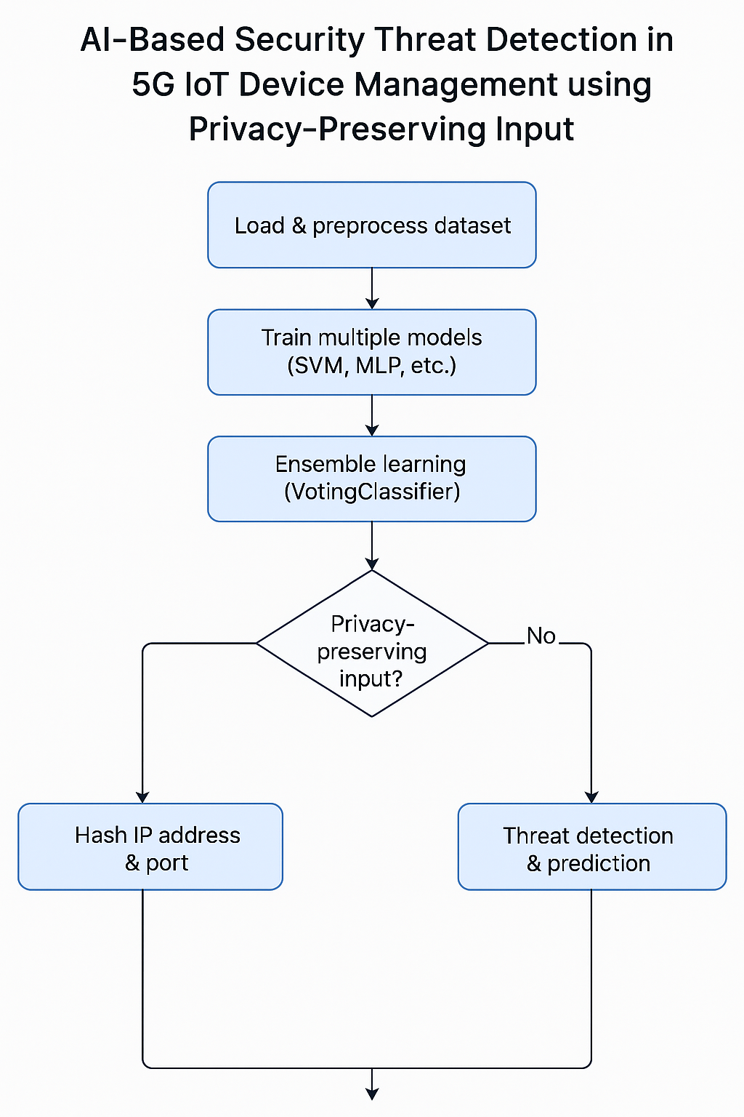
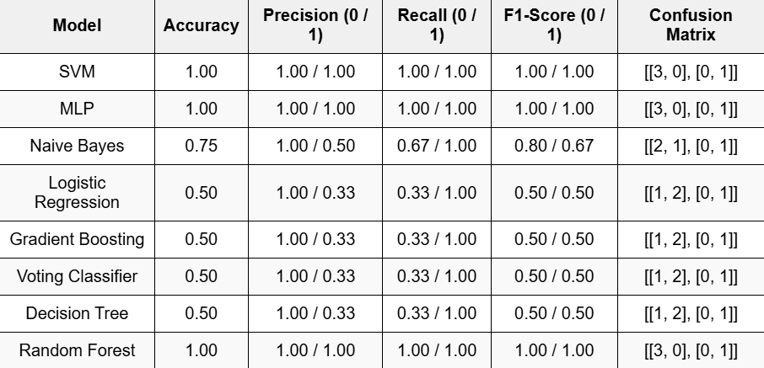
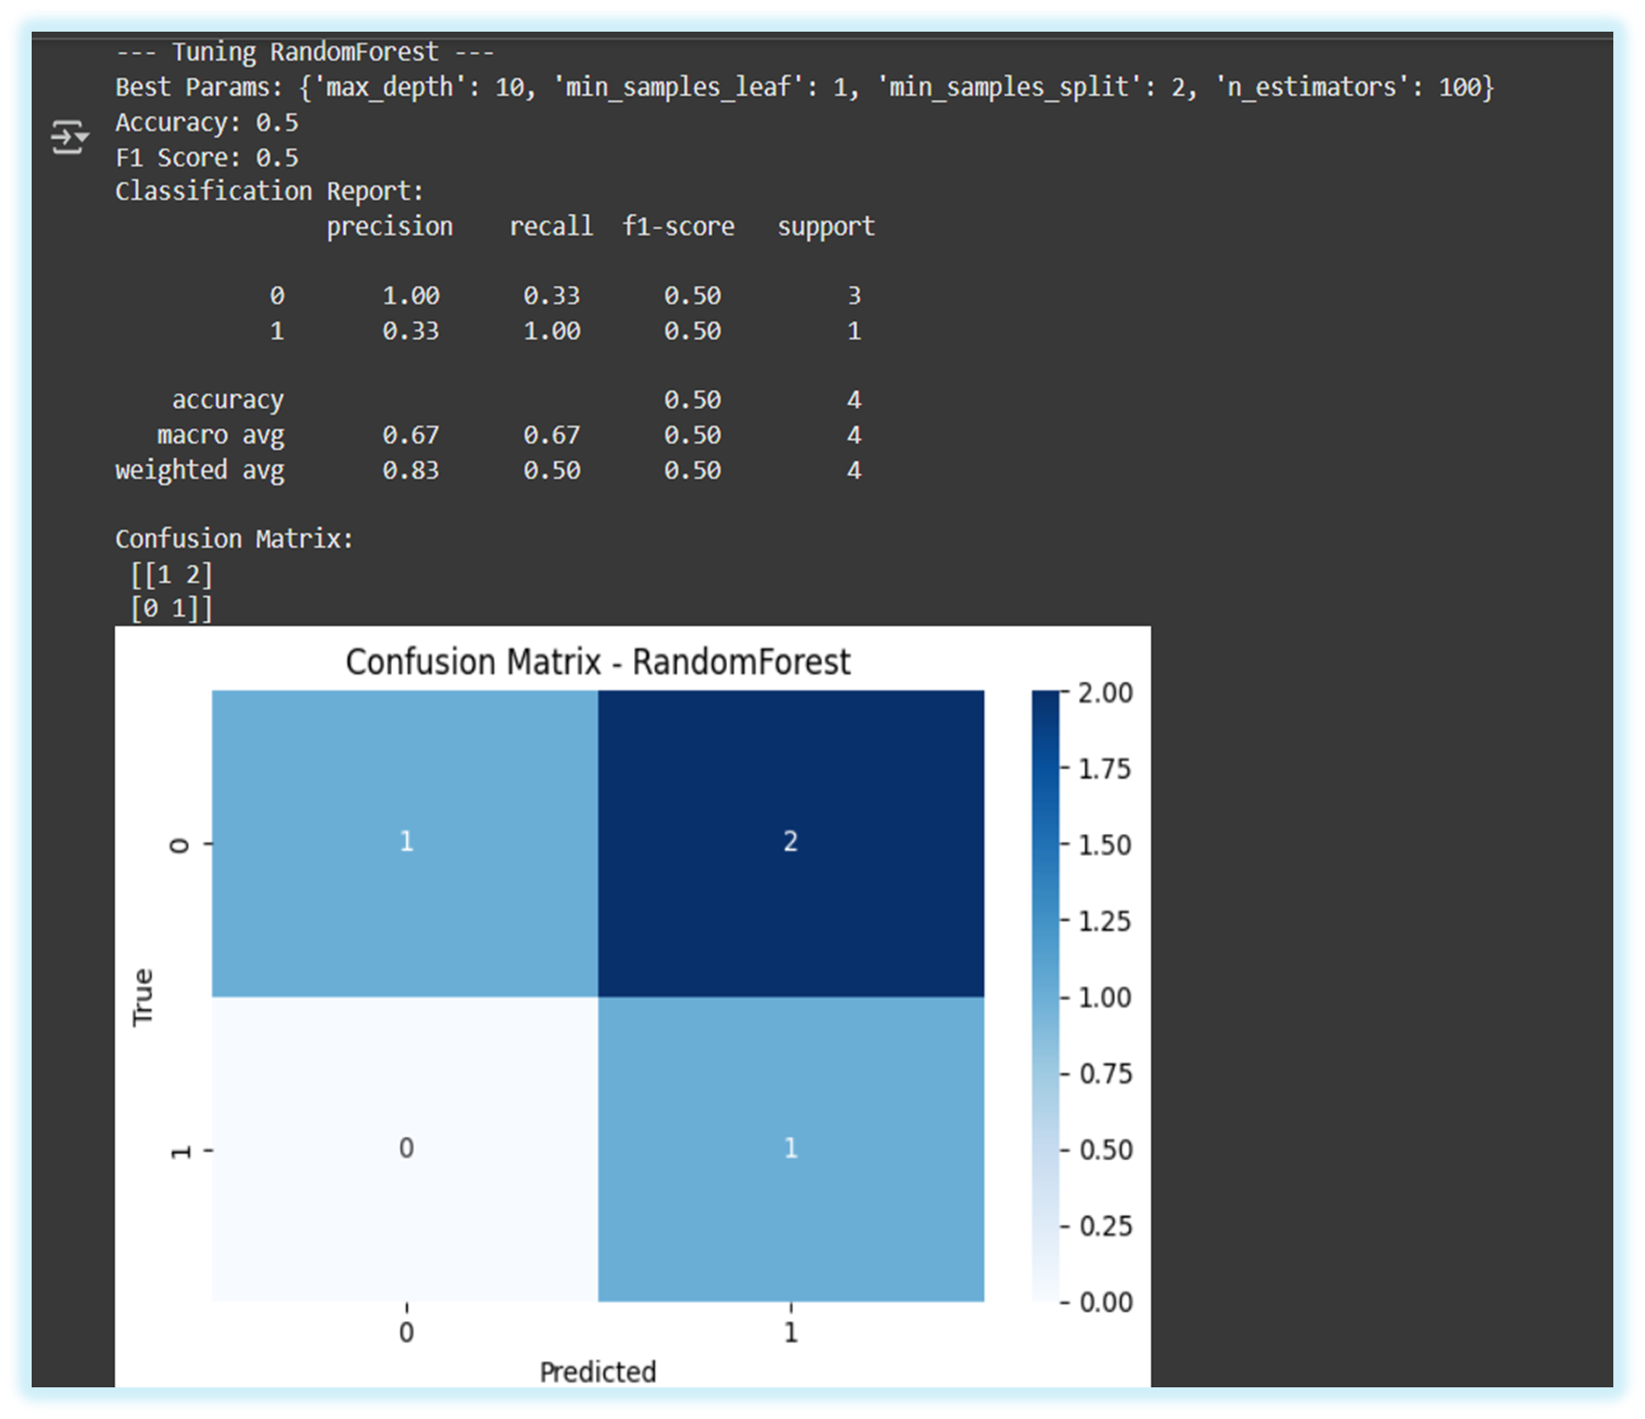
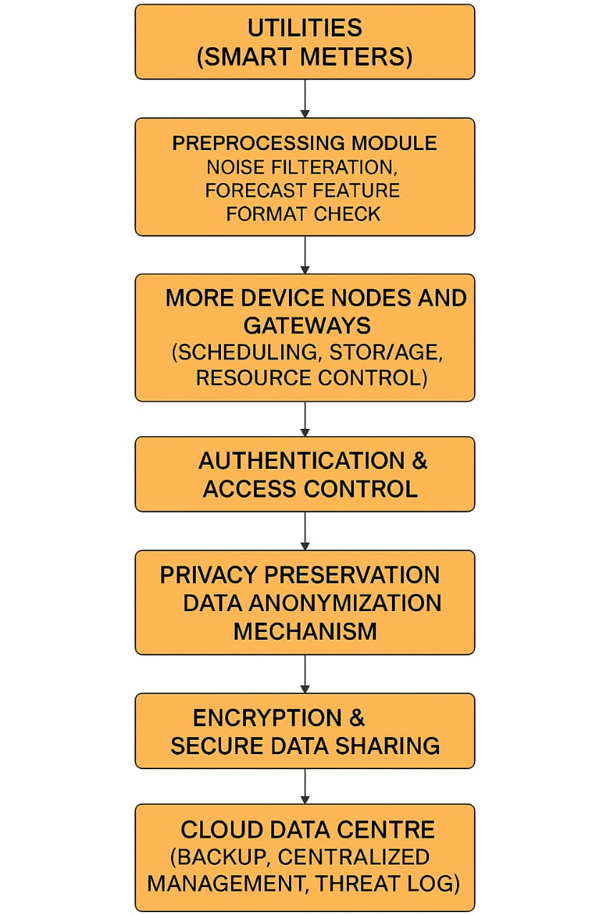
AI SECURITY THREATS IN 5G ENABLED IOT DEVICE MANAGEMENT
K Mahendra Kumar(RA2211052010029), D Bapuji Reddy (RA2211052010031), P Rushendra (RA2211067010013)
GUIDE: Dr.S.Murugaveni (Assistant Professor)
Department of Electronics and Communication Engineering, SRM Institute of Science and Technology, Kattankulathur
The combination of AI with 5G technology is transforming industries by enabling quicker data processing, automation, and real-time decision-making.
Encryption, AI-powered security monitoring, and difficult device authentication policies are required to reduce such threats and allow secure technological advancement.
AI systems based on large amounts of data are prone to data breaches, tampering, and hacking. IoT devices linked through 5G are especially vulnerable if not effectively secured.
Mobile-Edge Computing (MEC) faces critical security and privacy challenges due to its distributed nature, resource-constrained IoT devices.
Exposure to cyber threats like DDoS attacks, unauthorized access, and data breaches. Traditional security mechanisms struggle to protect MEC environments efficiently.
AI-Based Threat Detection: Detect data poisoning, adversarial attacks, and unauthorized access using intelligent authentication and control.
Smart Intrusion & Traffic Monitoring: Use AI to identify anomalies and predict suspicious network behavior in real time.
  Fig no – 2 system design of security implementation
Fig no 3 – accuracy of all the models used
Tuning Random forest final output
Technical limitations: Resource constraints (limited CPU/RAM/storage), network challenges (latency sensitivity, bandwidth limitations), and power restrictions (energy efficiency requirements for IoT devices and remote deployments).
Financial barriers: High initial implementation costs plus ongoing expenses for model maintenance and security monitoring.
This project developed a privacy-preserving AI security system for 5G IoT environments that hashes sensitive data while achieving 100% threat detection accuracy with optimized SVM and MLP models. The implementation includes comprehensive visualizations of system architecture and performance metrics, delivering an effective real-time security solution for modern IoT device management
P. Radanliev, R. De Roure, and D. Burnap, “AI Security and Cyber Risk in IoT Systems,” Frontiers in Artificial Intelligence, vol. 3, no. 5, pp. 1–10, 2024.
S. Pirbhulal, D. Zhang, and M. S. Islam, “IoT Cybersecurity in 5G and Beyond: A Systematic Literature Review,” ResearchGate, vol. 6, no. 1, pp. 90–105, 2024.
C. Wang, “The Security and Privacy of Mobile-Edge Computing: An Artificial Intelligence Perspective,” IEEE Xplore, vol. 45, no. 2, pp. 145–157, 2023
H. Kim, “A Study on the Security Threats and Privacy Policy of Intelligent Video Surveillance System Considering 5G Network Architecture,” IEEE Xplore, vol. 34, no. 7, pp. 345–360, 2023.
Journal of Network and Computer Applications (JNCA) - This journal regularly features papers addressing AI security in telecommunications infrastructure, including 5G-enabled IoT ecosystems and their unique vulnerabilities.
INTRODUCTION/ABSTRACT
METHODOLOGY
RESULTS & INFERENCE
CONCLUSION
REFERENCES
DESIGN
PROBLEM STATEMENT
OBJECTIVE
REALISTIC CONSTRAINTS
CONFERENCE /JOURNAL PUBLICATION

